Slide 1
Unit 203: Electrical installations technology
Cable tray and ladder systems

Slide 2
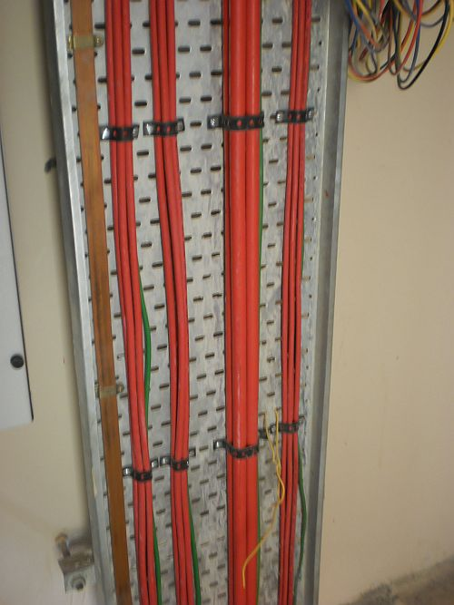
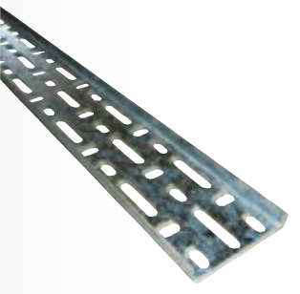
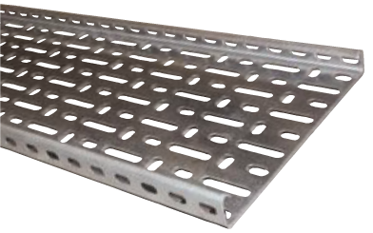
Cable tray and ladder systems
Three main types of cable tray:
standard duty cable tray
heavy-duty cable tray
return flange cable tray.

Slide 3
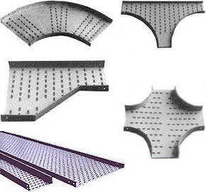
Cable tray and ladder systems
Cable tray accessories:

Slide 4
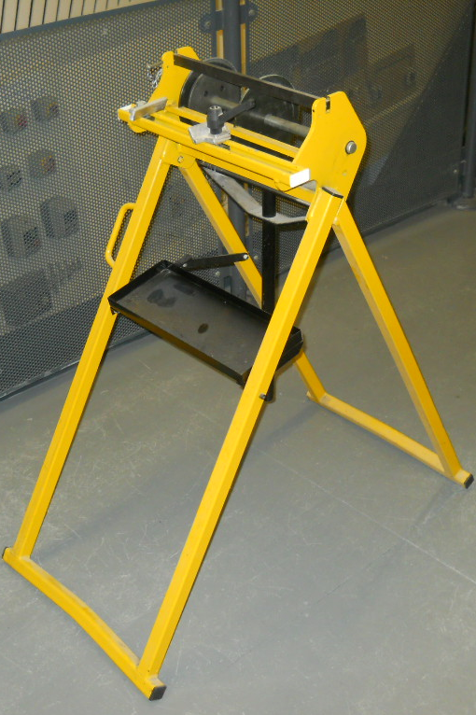
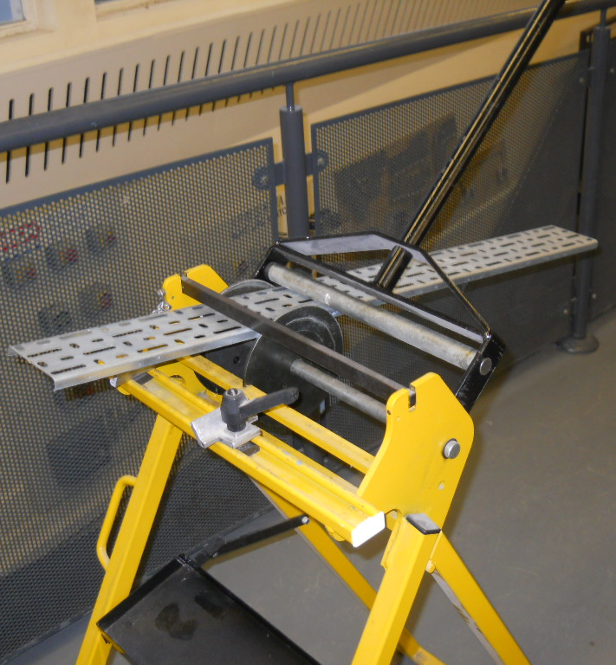
Cable tray and ladder systems
Cable tray specialist tools – tray bending machine

Slide 5
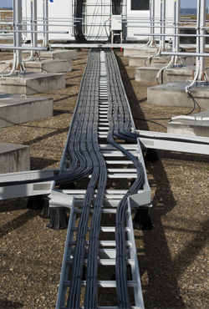
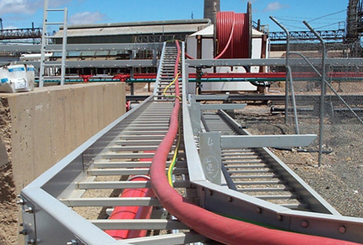
Cable tray and ladder systems
Cable ladder

Slide 6
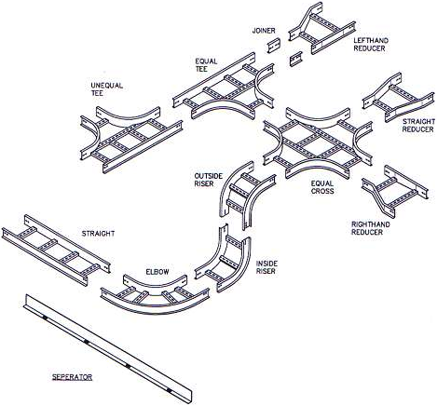
Cable tray and ladder systems
Cable ladder accessories

Slide 7
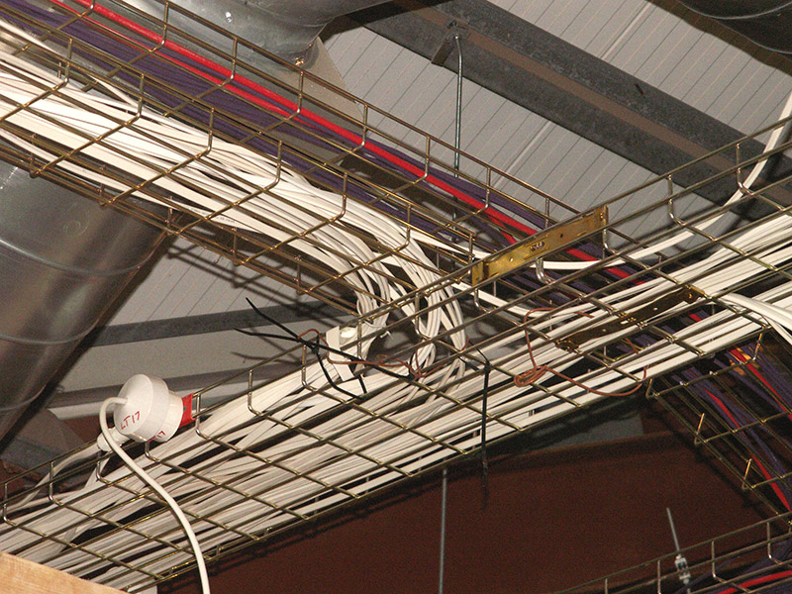
Cable tray and ladder systems
Cable basket

Slide 8
Unit 203: Electrical installations technology
The End

